Slide 1
FOOD DELIVERY
ANALYSIS
Gulshan Kumar
2320893

Slide 2
INDEX
OBJECTIVE OF THE PROJECT
SOURCE FILES
REQUIREMENTS
DESIGN TARGETS AND DEVELOPMENT
MAPPINGS AND TESTING OUTPUTS
TESTING DOCUMENTS
CONCLUSION

Slide 3
OBJECTIVE
The purpose of our project is to develop an ETL process using Informatica Power Center to integrate Food deliver data from multiple sources into a centralized system for effective Food delivery analysis and then perform different type of testing on it .

Slide 4
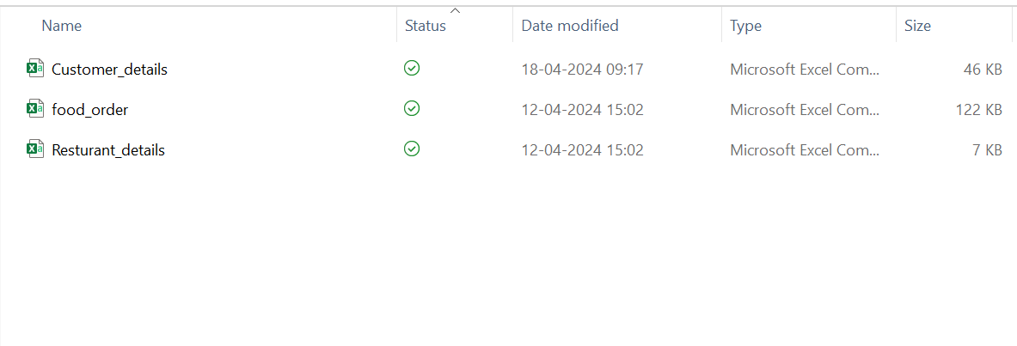
SOURCE FILES
Customer_details
Food_order
Resturant_details

Slide 5
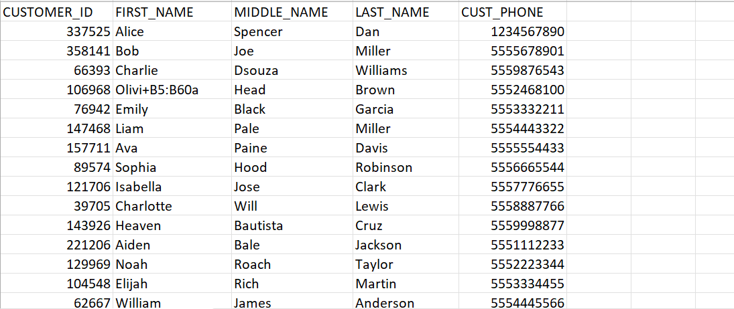
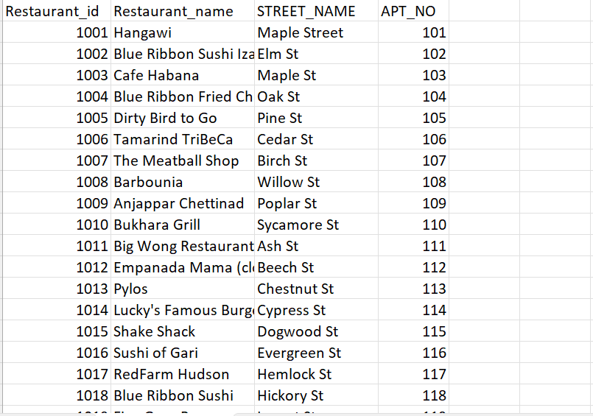
Customer_details :-
Resturant_details :-

Slide 6
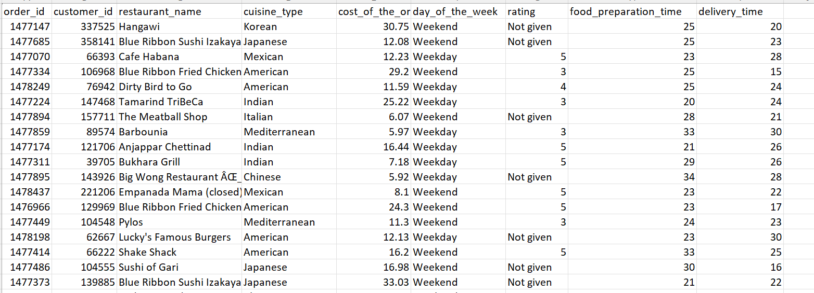
Food_order :-

Slide 7
REQUIREMENTS
Requirement 1:-
Customer Dimension – The Customer dimension table CUSTOMER_TARGET is a Type – I SCD table which contains all customer information. The source table name is CUSTOMER_SOURCE in which data is load from source file Customer_details.csv .
Requirement 2:-
Resturant Dimension - The Restaurant dimension table RESTURANT_DETAILS_TARGET is a
Type – I SCD which contains all Restaurant details. Data is added to this table, only when a new restaurant is being opened. So, the load schedule would be on demand. The source table name is RESTAURANT_DETAILS_SOURCE in which data is load from source file Resturant_details.csv .

Slide 8
Requirement 3:-
Results Staging - The results staging table STG_TABLE_FDA receives the results data from the different evaluation centers FOOD_ORDER_TARGET in which data is load from Food_order.csv . The information from different files is standardized in the staging table. The data is loaded with all related dimension information from the respective dimension tables in the warehouse.
Requirement 4:-
Results Fact - The results fact table FDA_FACT contains all the transactions loaded from the staging table STG_TABLE_FDA . This table is loaded only after the staging table has been loaded completely from the transaction files arriving from all the different centers.

Slide 9
Requirement 5 :-
Results Aggregate - The Sales Aggregate tables RESULT_WEEKDAY and RESULT_WEEKEND pulls data from the Results fact table FDA_FACT . The table is aggregated by Resturant_id .

Slide 10
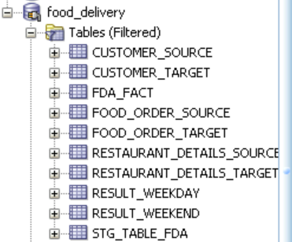
DESIGN TARGET AND DEVELOPMENTS
As per the requirements I have created target tables in sql developer as shown below:-

Slide 11
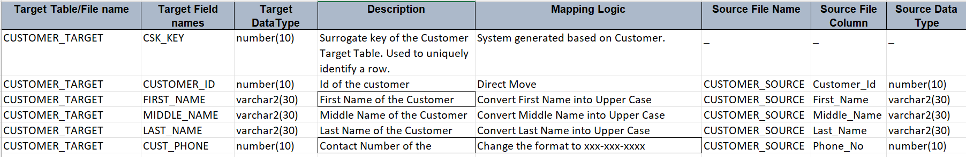
Mapping 1:-
CUSTOMER_SOURCE CUSTOMER_TARGET
Logic Used :-

Slide 12
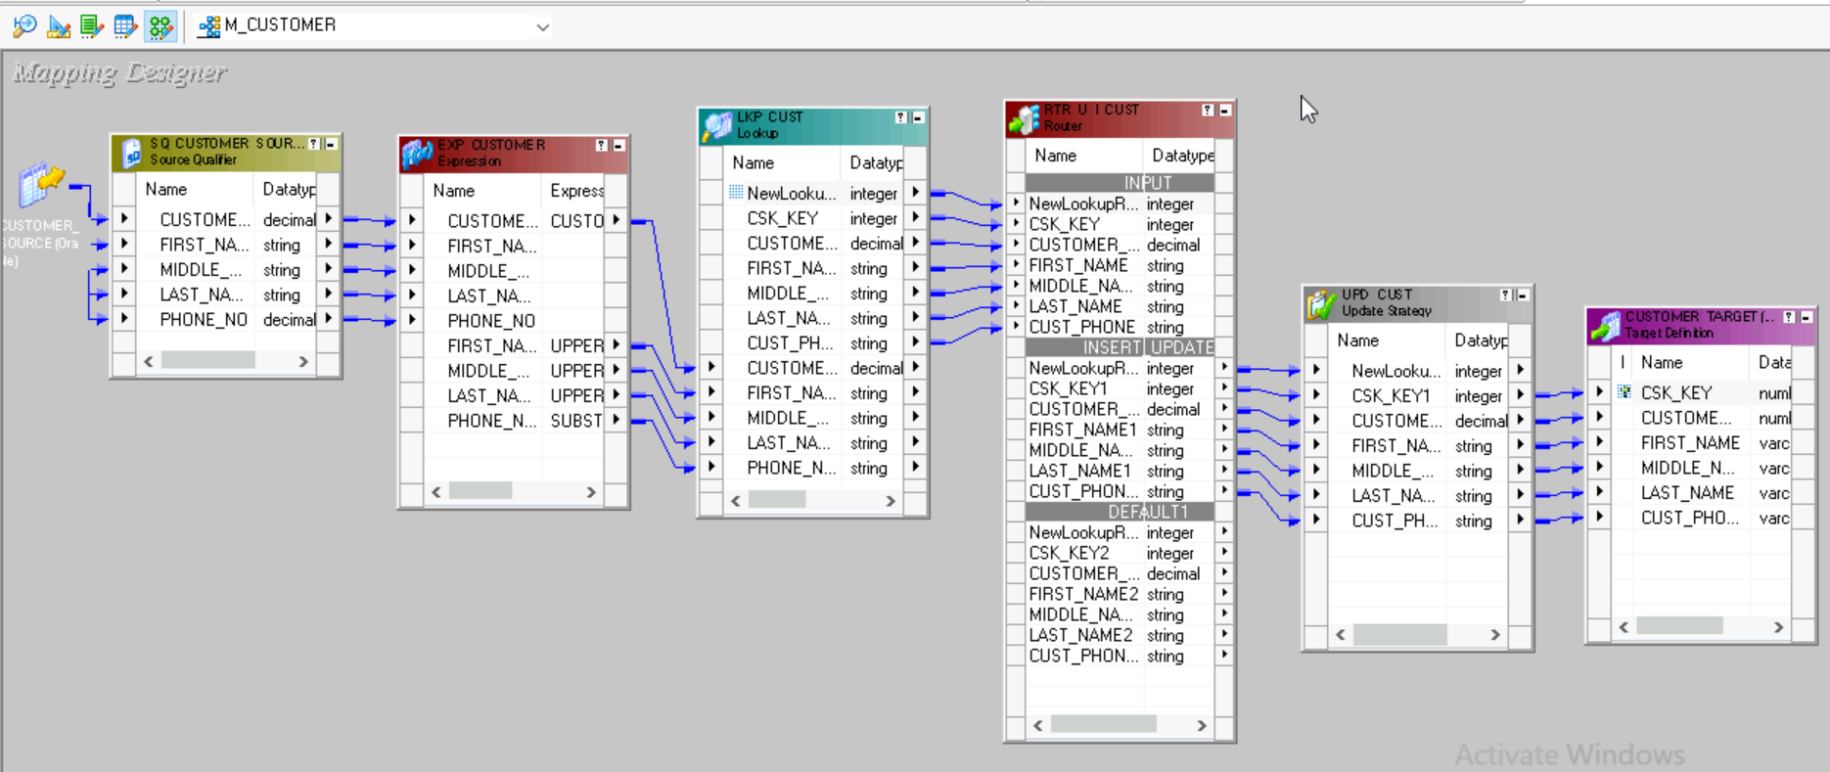
Mapping 1:-
CUSTOMER_SOURCE CUSTOMER_TARGET

Slide 13
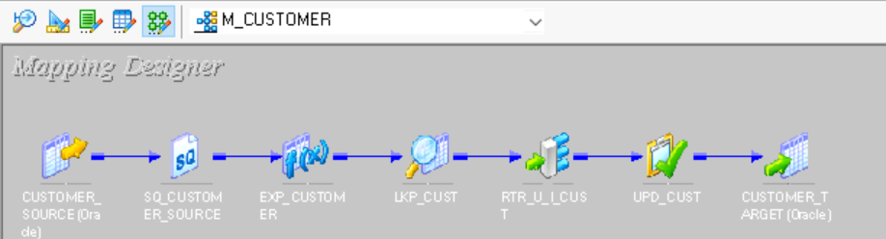
Iconize Mapping 1:-

Slide 14
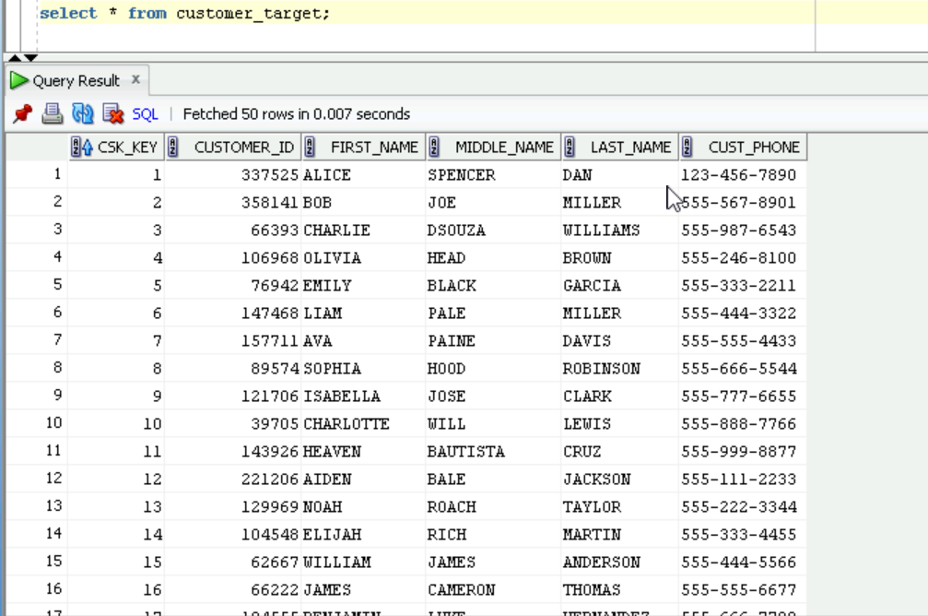
OUTPUT M1 :-

Slide 15
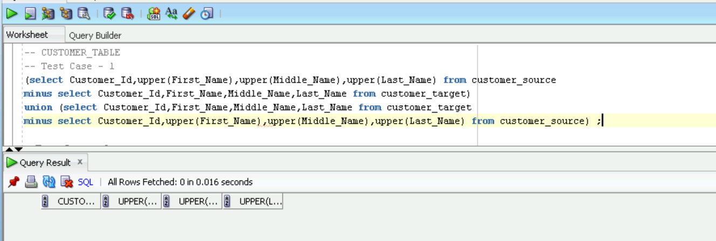
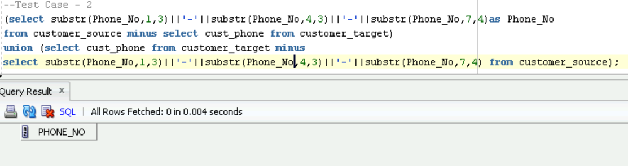
TESTING M1 :-
DATA VALIDATION:-

Slide 16
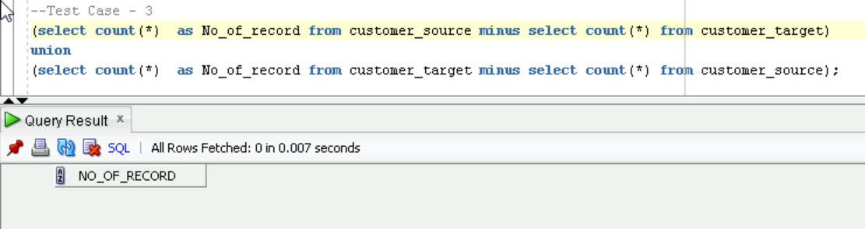
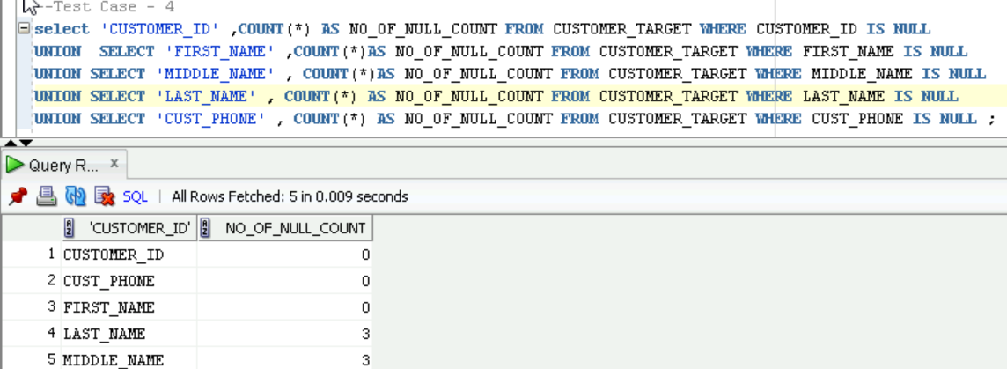
Count Validation :-
Null Validation :-

Slide 17
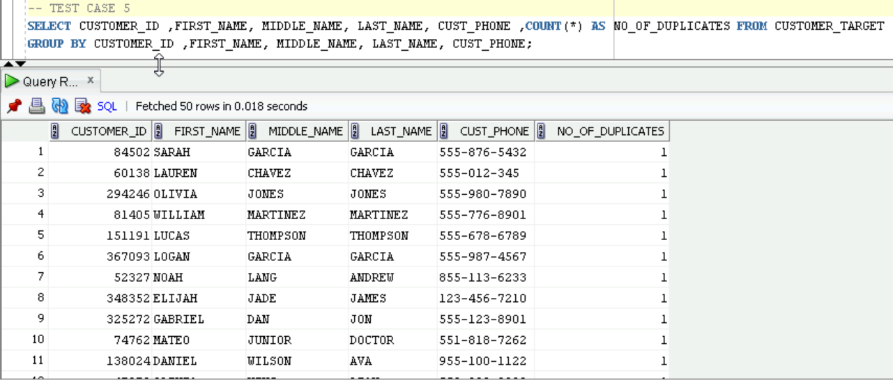
Duplicate Validation :-

Slide 18
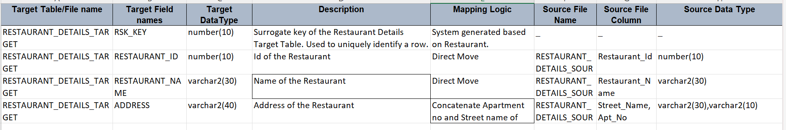
Mapping 2 :-
RESTAURANT_DETAILS_SOURCE RESTURANT_DETAILS_TARGET
Logic Used :-

Slide 19
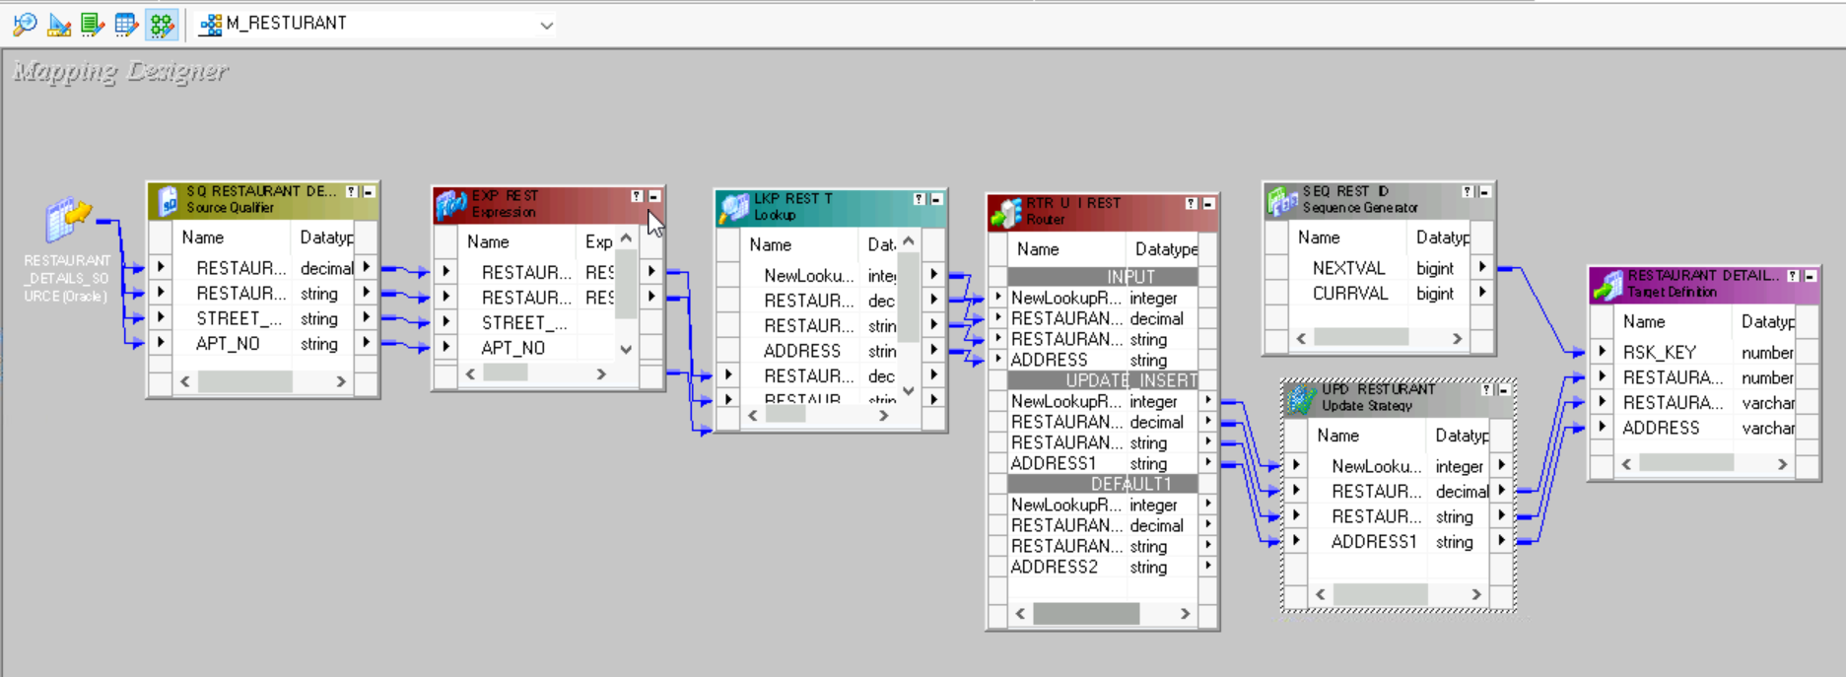
Mapping 2 :-
RESTAURANT_DETAILS_SOURCE RESTURANT_DETAILS_TARGET

Slide 20
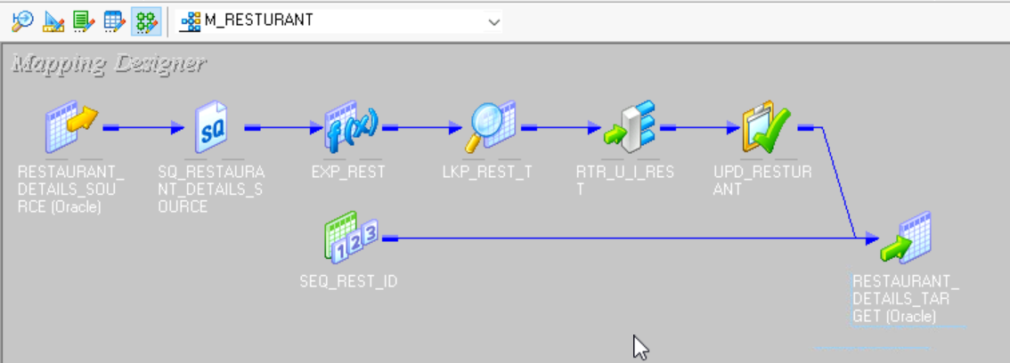
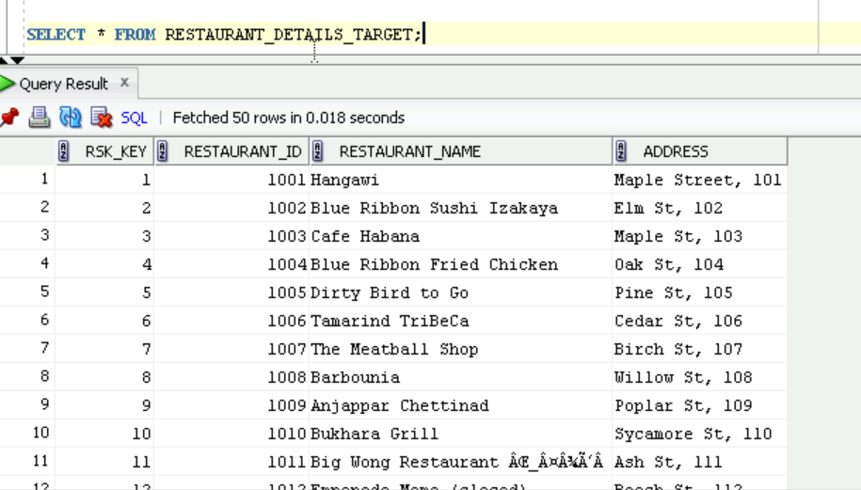
Iconize Mapping 2 :-
OUTPUT M2 :-

Slide 21
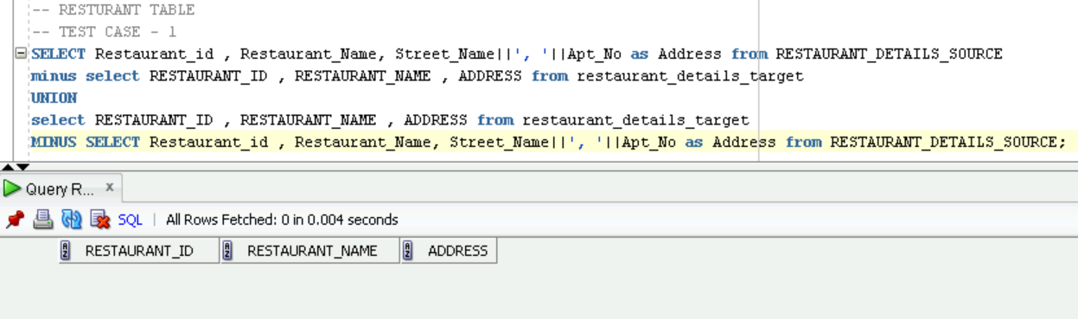
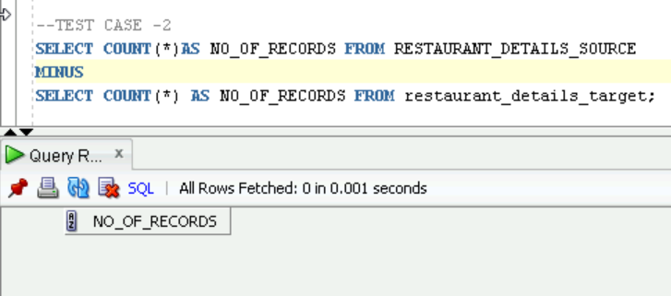
Testing Mapping 2 :-
Data Validation :-
Count Validation :-

Slide 22
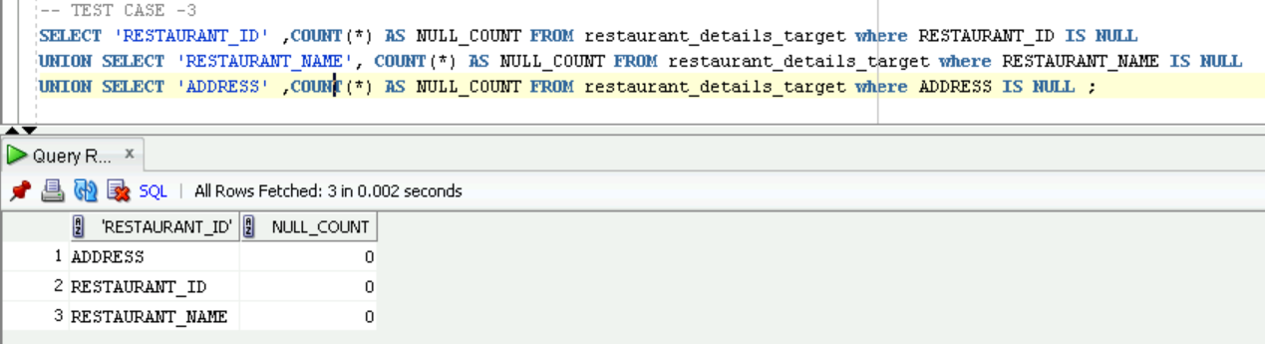
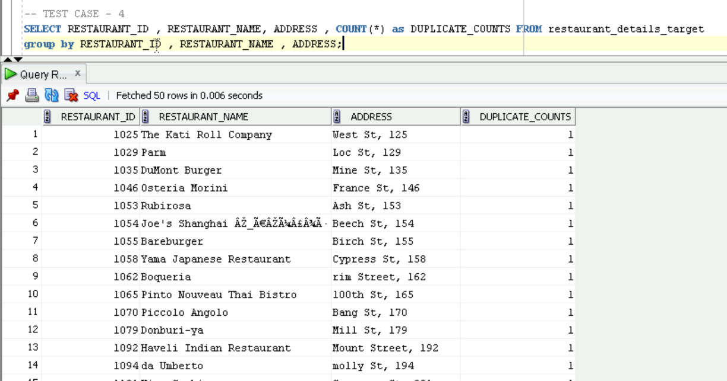
Null Validation :-
Duplicate Validation :-

Slide 23
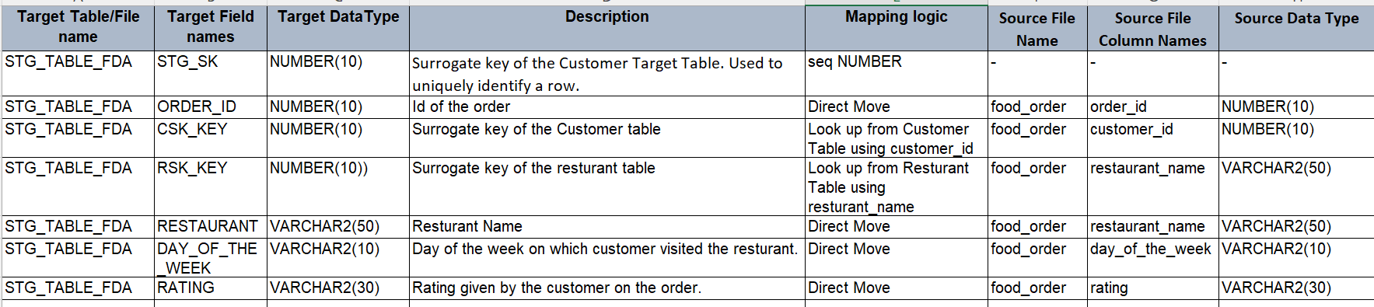
Mapping 3 :-
FOOD_ORDER_TARGET STG_TABLE_FDA
Logic Used :-

Slide 24
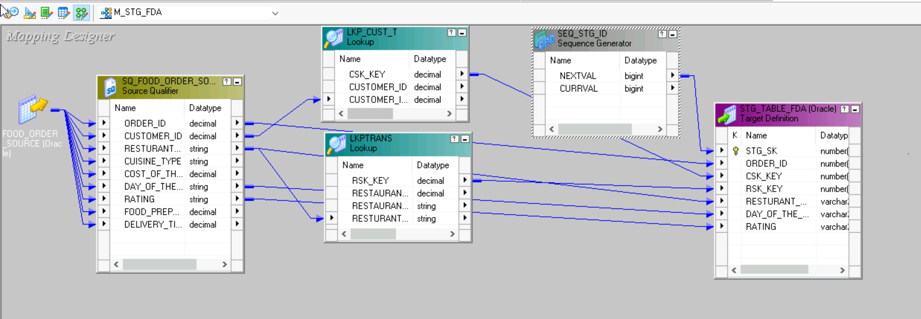
Mapping 3 :-
FOOD_ORDER_TARGET STG_TABLE_FDA

Slide 25
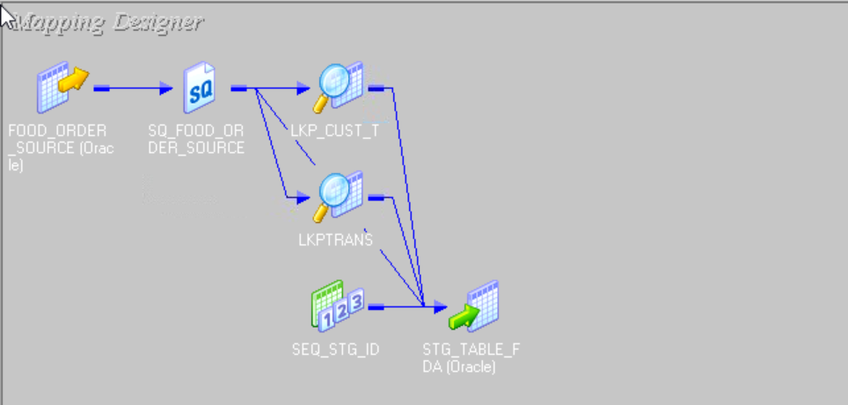
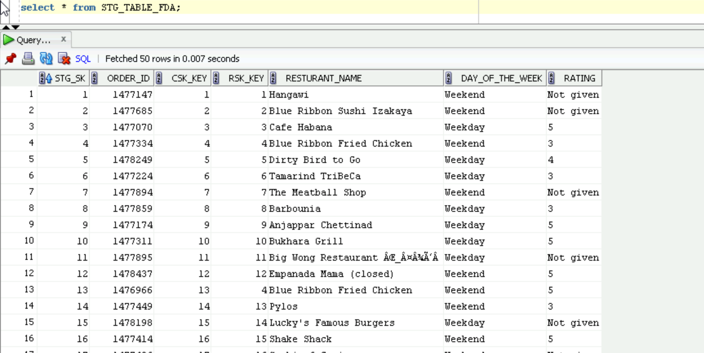
Iconize Mapping 3:-
OUTPUT M3:-

Slide 26
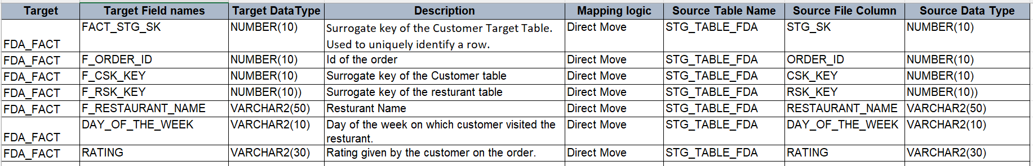
Mapping 4:-
STG_TABLE_FDA FDA_FACT
Logic Used :-

Slide 27
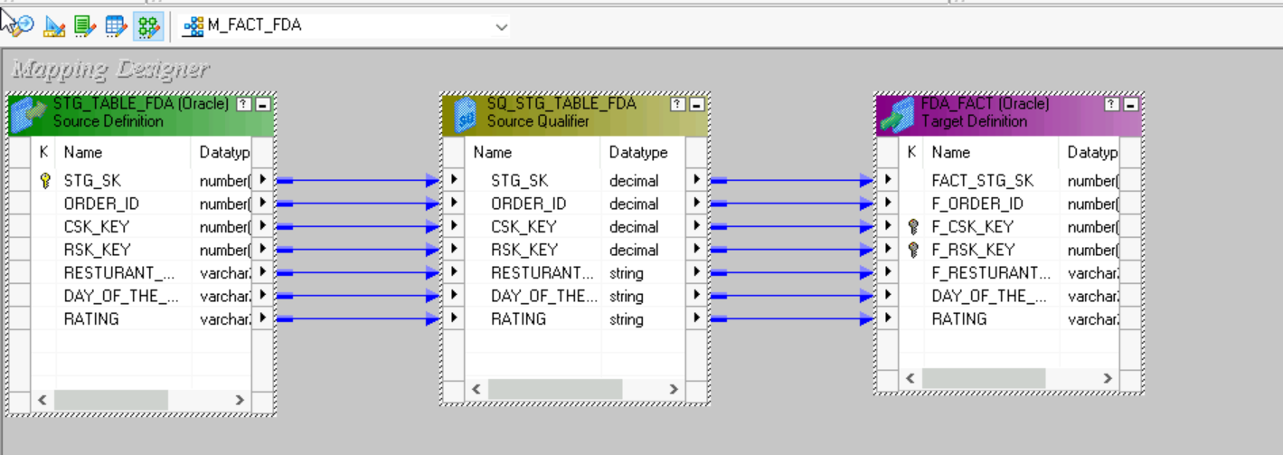
Mapping 4:-
STG_TABLE_FDA FDA_FACT

Slide 28
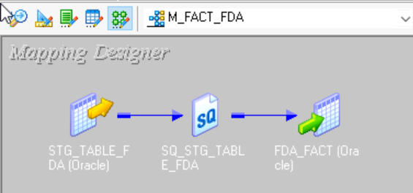
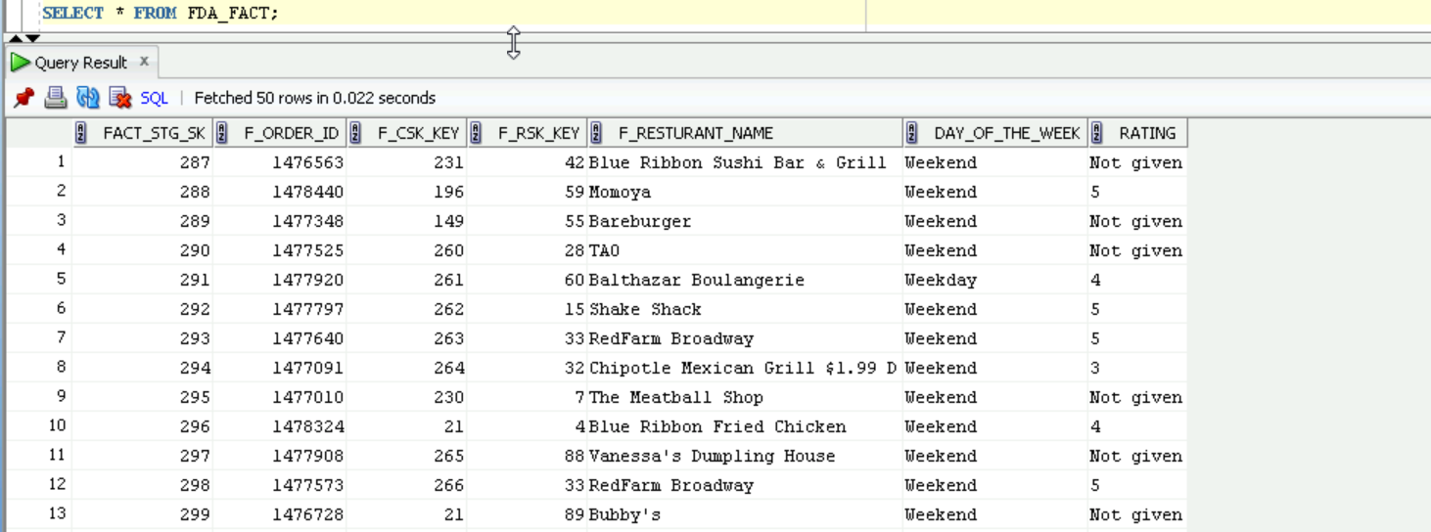
Iconize Mapping 4:-
OUTPUT M4 :-

Slide 29
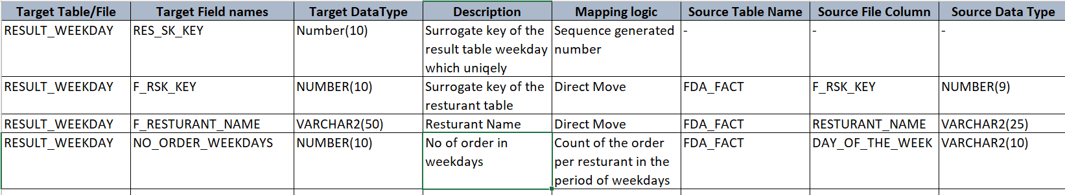
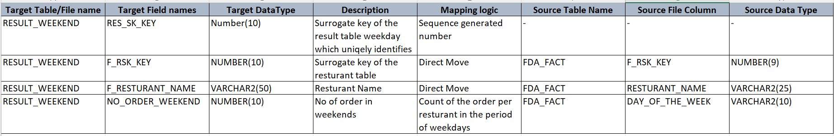
Mapping 5:-
FDA_FACT RESULT_WEEKDAY & RESULT_WEEKEND
Logic Used :-

Slide 30
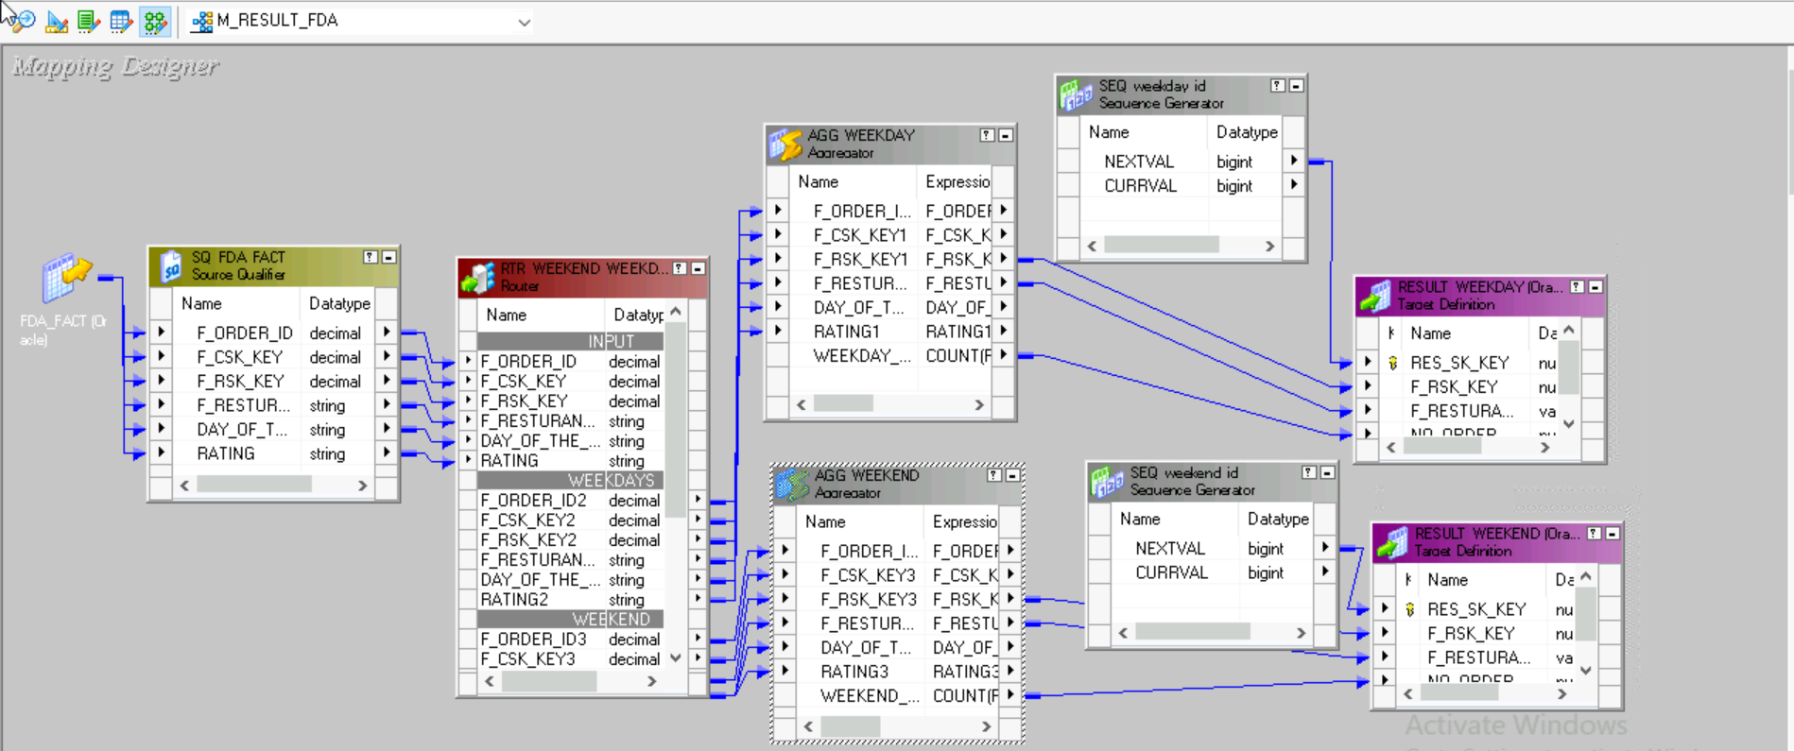
Mapping 5:-
FDA_FACT RESULT_WEEKDAY & RESULT_WEEKEND

Slide 31
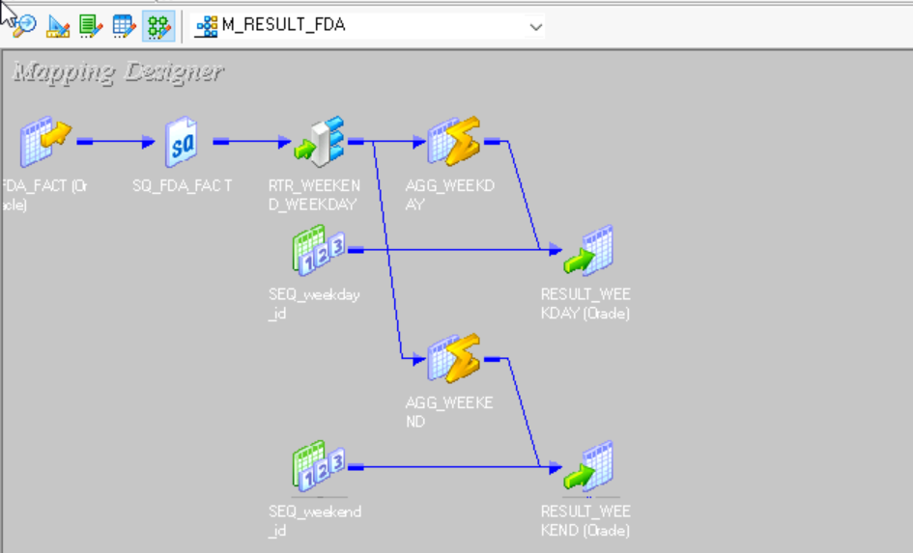
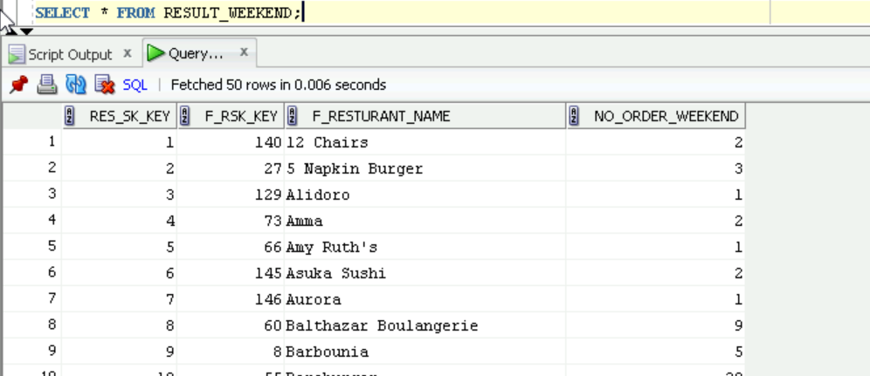
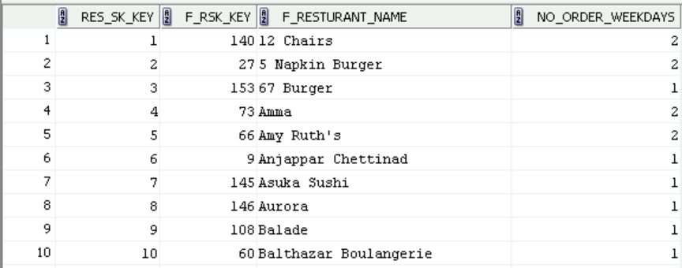
Iconize Mapping 5 :-
OUTPUT M5 :-

Slide 32
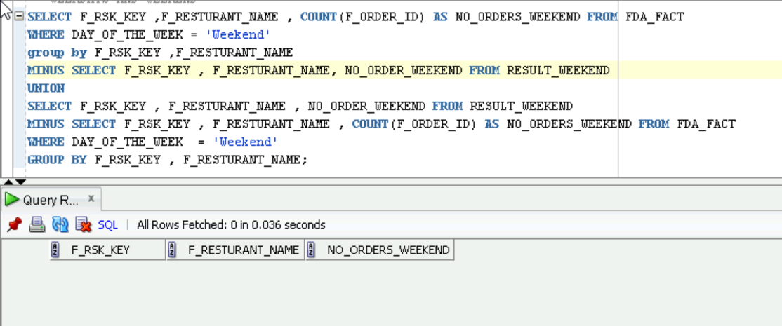
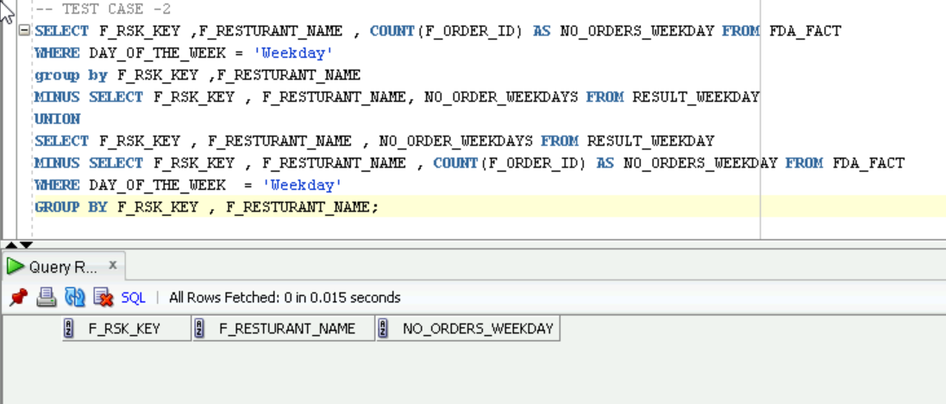
Testing Mapping 5 :-
Data Validation :-

Slide 33
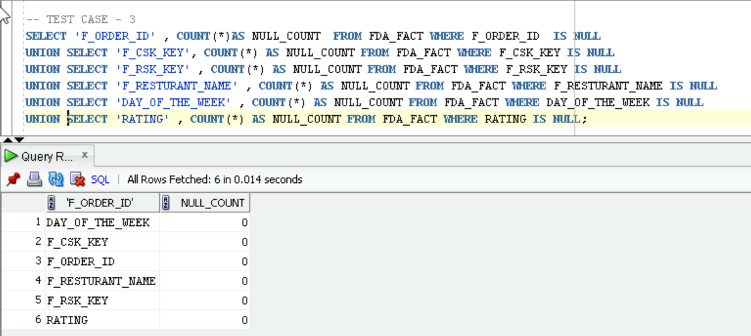
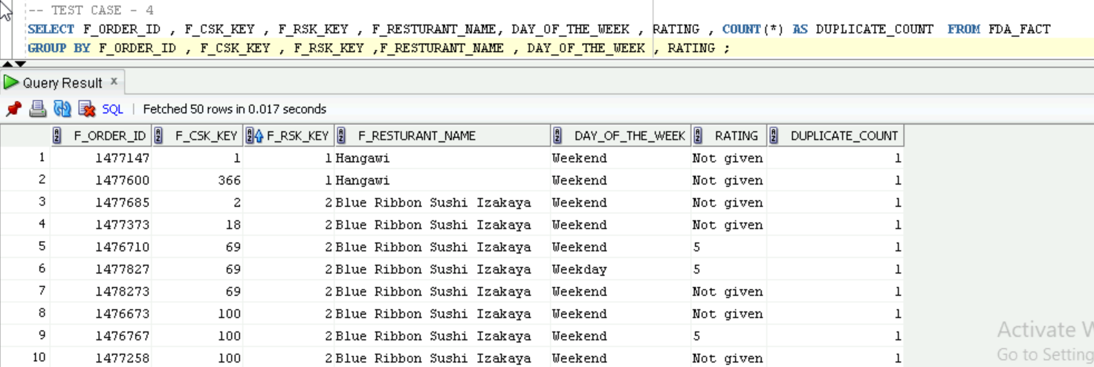
Null Validation :-
Duplicate Validation :-

Slide 34
TESTING DOCUMENTS :-

Slide 35
CONCLUSION :-
As per the requirements I have successfully upload the source data into targets .
As per the requirements I have clean the data and changed the formats of the sources by using multiple type of transformation .
I have successfully calculated Total number of order done in weekend and weekdays .
I have successfully performed ETL testing on the developed mappings.

Slide 36
THANK YOU

